Slide 1

Application and websecurity
Lab experiment – 4
Create a Sandbox (Self Hosted Virtualbox) to Run Malware in Control Environment

Slide 2
Lab experiment – 4
Create a Sandbox (Self Hosted Virtualbox) to Run Malware in Control Environment
What Is Malware?
Malware is any piece of software that’s harmful to your system — worms, viruses, trojans, spyware, etc. Discovering them continues to be a challenge as attackers are writing increasingly sophisticated programs to evade detection. Malware analysis can help you to determine if a suspicious file is indeed malicious, study its origin, process, capabilities, and assess its impact to facilitate detection and prevention.
Malware can be distributed via various channels like emails (phishing attacks), USB drives, downloading software from websites, etc. They disguise themselves using obfuscation methods to mimic legitimate files or applications to trick users into downloading them. Once malicious software compromises a host system, it uses various persistence techniques (such as altering system files or adding malicious code) to remain there until a trigger event launches the attack.

Slide 3
Lab experiment – 4
Create a Sandbox (Self Hosted Virtualbox) to Run Malware in Control Environment
Types of Malware Analysis Techniques:
Types of malware analysis include static, dynamic or a hybrid of the two.
The static analysis does not analyze the code when it is running. Instead, it examines files for malicious intent. This makes it useful to identify infrastructure, packed files, and libraries. Some technical indicators can be used to determine if the file is malicious. However, since it does not run the code, it is difficult to detect sophisticated malware.
Dynamic analysis executes any suspicious malicious code in a secure environment called a sandbox. It enables security professionals to watch the malware in action and not impacting the risk of infecting the system. It offers deeper visibility to reveal the true nature of the threat. It also reduces the time to rediscover a file with malicious code. Hackers and adversaries often hide code in a sandbox that will not run until some conditions are met.
The hybrid analysis is a combination of basic and dynamic techniques to provide the best of both approaches. It detects malicious codes and extracts more indicators of compromise. It can even help detect this in sophisticated malware.

Slide 4
Lab experiment – 4
Create a Sandbox (Self Hosted Virtualbox) to Run Malware in Control Environment
Static vs. Dynamic
In the table below, we break down the differences between these two malware analysis techniques:
Static Malware Analysis | Dynamic Malware Analysis
The malware components and properties are analyzed without running the code. | The malware is executed within a virtual environment, and its behavior is observed.
Static malware analysis is signature-based — i.e., the signature of the malware binary is determined by calculating the cryptographic hash. | Dynamic malware analysis takes a behavior-based approach to malware detection and analysis.
The malware binary can be reverse-engineered by using a disassembler. | The malware binary can be reverse-engineered using disassemblers and debuggers to understand and control certain aspects of the program when executing.
Static malware analysis involves virus scanning, fingerprinting, memory dumping, etc. | Dynamic malware analysis involves registry changes, API calls, memory writes, etc.
It can be rendered ineffective against unknown or new malware types or in more sophisticated attack scenarios. | It is more effective and provides a higher detection rate than static analysis.

Slide 5
Lab experiment – 4
Create a Sandbox (Self Hosted Virtualbox) to Run Malware in Control Environment
Lab Layout - Self-Hosted (VirtualBox)
Download Virtual box
Download VirtualBox Link: https://www.virtualbox.org/wiki/Downloads
Download windows 10 Enterprise ISO
Download Windows 10 Enterprise Link: https://info.microsoft.com/ww-landing-windows-10-enterprise.html https://www.microsoft.com/en-us/evalcenter/download-windows-10-enterprise
Setup flare vm
Download Remnux
Download Remnux (virtual box ova box version) Link: https://docs.remnux.org/install-distro/get-virtual-appliance
Setup EC2 Instance
Setup AMI
Setup Terraform

Slide 6
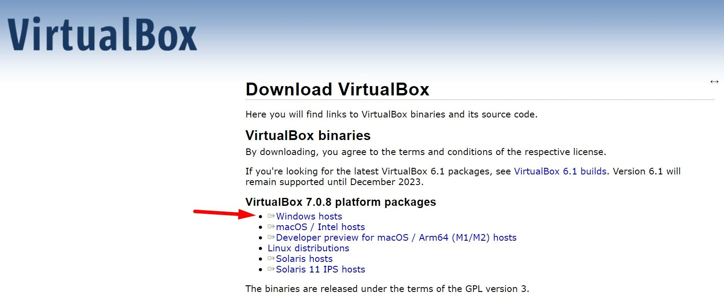
Lab experiment – 4
Create a Sandbox (Self Hosted Virtualbox) to Run Malware in Control Environment
Lab Layout - Self-Hosted (VirtualBox)
STEPS TO INSTALL VIRTUALBOX IN WINDOWS USING WINDOWS INSTALLER
STEPS
To Download Virtual Box visit the given link https://www.virtualbox.org/wiki/Downloads
Click on "Windows hosts" option to download the .exe installer.

Slide 7
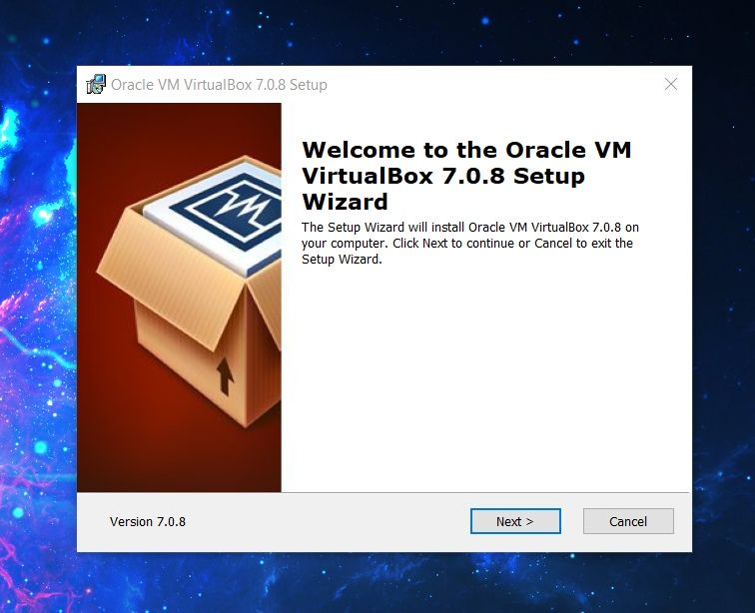
Lab experiment – 4
Create a Sandbox (Self Hosted Virtualbox) to Run Malware in Control Environment
Lab Layout - Self-Hosted (VirtualBox)
STEPS TO INSTALL VIRTUALBOX IN WINDOWS USING WINDOWS INSTALLER
STEPS
Once you download the installer (.exe) file, here's what is next after launching it:

Slide 8
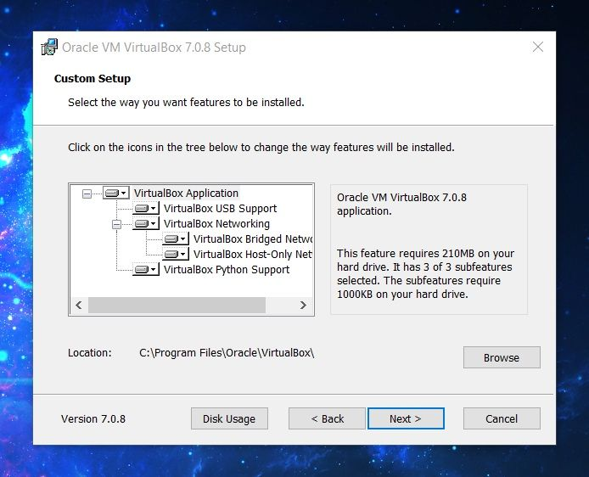
Lab experiment – 4
Create a Sandbox (Self Hosted Virtualbox) to Run Malware in Control Environment
Lab Layout - Self-Hosted (VirtualBox)
STEPS TO INSTALL VIRTUALBOX IN WINDOWS USING WINDOWS INSTALLER
STEPS
The installation instructions let you choose a location to get it installed to. You should stick with the defaults on the C: drive to ensure everything essential gets installed for VirtualBox to work as expected.

Slide 9
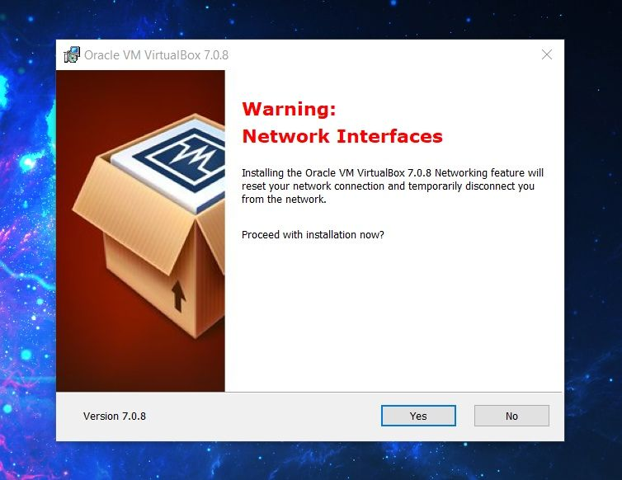
Lab experiment – 4
Create a Sandbox (Self Hosted Virtualbox) to Run Malware in Control Environment
Lab Layout - Self-Hosted (VirtualBox)
STEPS TO INSTALL VIRTUALBOX IN WINDOWS USING WINDOWS INSTALLER
STEPS
The installation process includes setting up virtual network interfaces. So, your network might get reset at the moment. Ensure that you are not connected to anything important at the time of installing it.

Slide 10
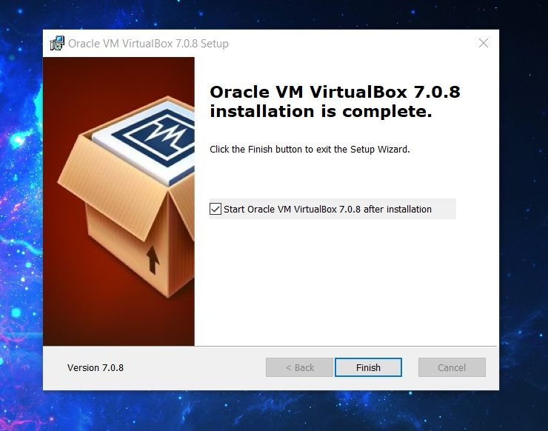
Lab experiment – 4
Create a Sandbox (Self Hosted Virtualbox) to Run Malware in Control Environment
Lab Layout - Self-Hosted (VirtualBox)
STEPS TO INSTALL VIRTUALBOX IN WINDOWS USING WINDOWS INSTALLER
STEPS
Now, the final installation process will begin as per your preferences above, and it will present you with the option to launch VirtualBox upon closing the installer.

Slide 11
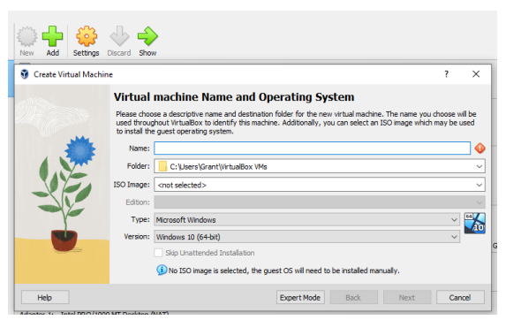
Lab experiment – 4
Create a Sandbox (Self Hosted Virtualbox) to Run Malware in Control Environment
Lab Layout - Self-Hosted (VirtualBox)
STEPS TO INSTALL WINDOWS 10 GUEST ADDITION IN VIRTUAL BOX
STEPS
Open virtualbox and click on new.

Slide 12
Lab experiment – 4
Create a Sandbox (Self Hosted Virtualbox) to Run Malware in Control Environment
Lab Layout - Self-Hosted (VirtualBox)
STEPS TO INSTALL WINDOWS 10 GUEST ADDITION IN VIRTUAL BOX
STEPS
Give the name as (flarevm-windows 10) and select version windows 10 32/64 bit depending upon your pc hardware.
Select amount of memory (Ram) in mb to be allocated to virtual machine and click on next.
Create a new virtual hard disk now ( the recommended size of hard disk should be 60 gb or more ).
Now click on create
Select hard disk file type as VDI ( Virtual disk image) and click on next.
Select storage on physical hard disk. Let the PC dynamically allocate the size and click on next.
Select file location and size as you want to install it in selected location in pc and click on create.
Go ahead and click start
Choose startup disk an iso image of windows.
Now click on optical disk selector and add iso image of windows 10
After choosing iso image click on start windows 10 logo will appear which means every step is followed correctly.

Slide 13
Lab experiment – 4
Create a Sandbox (Self Hosted Virtualbox) to Run Malware in Control Environment
Lab Layout - Self-Hosted (VirtualBox)
STEPS TO INSTALL WINDOWS 10 GUEST ADDITION IN VIRTUAL BOX
STEPS
Click on next and Install now option
Windows setup box will appear click on new in right corner and select disk size and click on next.
In next step make sure Drive 0 partition 2 is selscted and click on next.
Wait a while let your pc install windows 10
Configure windows 10 settings by choosing default settings.
Sign dialogue box will appear instead of sign in click on domain join.
Give the user name password to your windows 10 and turn of all the privacy settings.
After the successful installation of windows 10 go up and select devices and click on insert guest image cd options.
Move on to file explorer and click on this pc option.
Select cd drive and choose virtual box windows 10 additions.
Select yes to allow changes to your devices and click next to install.
Now reboot your windows 10 virtual box.
After rebooting download google chrome.

Slide 14
Lab experiment – 4
Create a Sandbox (Self Hosted Virtualbox) to Run Malware in Control Environment
Lab Layout - Self-Hosted (VirtualBox)
STEPS TO INSTALL WINDOWS 10 GUEST ADDITION IN VIRTUAL BOX
STEPS(OPTIONAL ONLY FOR OLD WINDOW NOT FOR LATEST LIKE 10 or 11)
Download Windows Terminal: Download the VCLibs package. In a PowerShell window, run:
wget https://aka.ms/Microsoft.VCLibs.x64.14.00.Desktop.appx -usebasicparsing -o VCLibs.appx
Download the Windows Terminal MSIX bundle from the provided link:
wgethttps://github.com/microsoft/terminal/releases/download/v1.15.3465.0/Microsoft.windowsTerminal_Win10_1.15.3465.0_8wekyb3d8bbwe.msixbundle -UseBasicParsing -o winterminal.msixbundle
In a PowerShell admin window, add the VCLibs package: Add-AppxPackage [C:\path\to\downloaded\VCLibs.appx] In a PowerShell admin window, run: Add-AppxPackage [C:\path\to\downloaded\winterminal.msixbundle]

Slide 15
Lab experiment – 4
Create a Sandbox (Self Hosted Virtualbox) to Run Malware in Control Environment
Lab Layout - Self-Hosted (VirtualBox)
STEPS TO INSTALL WINDOWS 10 GUEST ADDITION IN VIRTUAL BOX
STEPS
Disable proxy auto detect setting
In the Windows search bar, search “proxy settings”,
Switch "Automatically detect settings" button off
Disable Windows Defender
Disable Tamper Protection
Search "Defender", open Defender settings and set all Defender Settings to off.
Disable Windows Defender in GPO
In the Windows Search Bar, search and select "edit group policy"
In GPO, navigate to → Administrative Templates → Windows Components → Microsoft Defender
Antivirus → Enable “Turn off Microsoft Defender Antivirus”
Disable Windows Firewall
GPO → Administrative Templates → Network → Network Connections → Windows Defender
Firewall → Domain Profile → Disable “Protect All Network Connections”
Do the same but for the Standard profile
Take a snapshot by clicking on machine and save it as windows 10 base.

Slide 16
Lab experiment – 4
Create a Sandbox (Self Hosted Virtualbox) to Run Malware in Control Environment
Lab Layout - Self-Hosted (VirtualBox)
STEPS TO INSTALL AND DOWNLOAD FLAREVM
STEPS
In PowerShell Admin prompt, run:
(New-Objectnet.webclient).DownloadFile('https://raw.githubusercontent.com/mandiant/flarevm/main/install.ps1',"$([Environment]::GetFolderPath("Desktop"))\\install.ps1")
Change directories to the Desktop : cd C:\Users\grant\Desktop
Run: Unblock-File .\\install.ps1
Run: Set-ExecutionPolicy Unrestricted
Accept the prompt to set the ExecPol to unrestricted if one appears
Run: .\\install.ps1
Follow the rest of the prompts and continue with the installation.
Take Snapshot This is the base FlareVM installation.
Now setup Remnux which we installed earlier
To setup Remnux go to my files section of virtual box and import appliances
Choose the path of remnux where your remnux file is stored click next and finish the installation process.

Slide 17
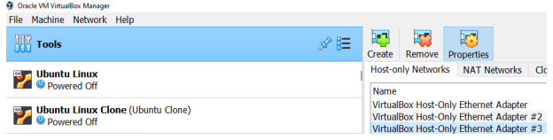
Lab experiment – 4
Create a Sandbox (Self Hosted Virtualbox) to Run Malware in Control Environment
Lab Layout - Self-Hosted (VirtualBox)
STEPS TO CONFIGURE VIRTUALBOX NETWORK SETTINGS
STEPS
Create an isolated host-only adapter network for Windows 10 machine and Remnux to talk to each other.
Create a new Host-only Network in both windows virtual machine and remnux.

Slide 18
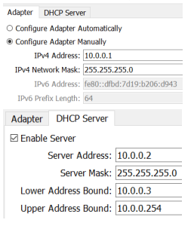
Lab experiment – 4
Create a Sandbox (Self Hosted Virtualbox) to Run Malware in Control Environment
Lab Layout - Self-Hosted (VirtualBox)
STEPS TO CONFIGURE VIRTUALBOX NETWORK SETTINGS
STEPS
Right Click -> Properties. Set IPv4 Address to a separate private range (ex. 10.0.0.1).
Set DHCP Server address to x.x.x.2, lower bound to x.x.x.3 and upper to x.x.x.254

Slide 19
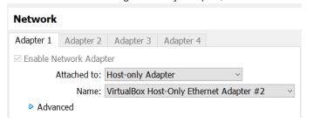
Lab experiment – 4
Create a Sandbox (Self Hosted Virtualbox) to Run Malware in Control Environment
Lab Layout - Self-Hosted (VirtualBox)
STEPS TO CONFIGURE VIRTUALBOX NETWORK SETTINGS
STEPS
Ensure all VMs are using Host-only Adapter, Isolated Ethernet Adapter
Download Sysinternal file library by typing sysinternal Microsoft in search bar of your browser
Go to downloads select sysinternal suite and download that file.
Now create a new folder in
C:>programdata>Microsoft>windows>startmenu>program>Tools
Note : create a new folder sysinternals and extract the sysinternal zip file here. If you don’t get the tools folder create a sysinternal folder in programs
Creating a Fake Network in Remnux
Run inetsim in command prompt to start network service
Edit the config file in /etc/inetsim/inetsim.conf .
Uncomment start_service dns
Set the service_bind_address to 0.0.0.0
Set the DNS Default IP to IP address of Remnux VM address. (10.0.0.4)

Slide 20
Lab experiment – 4
Create a Sandbox (Self Hosted Virtualbox) to Run Malware in Control Environment
Lab Layout - Self-Hosted (VirtualBox)
STEPS TO CONFIGURE Windows VIRTUALBOX NETWORK SETTINGS
STEPS
Go to windows vm box
Go to searchbar type ethernet settings
Click on change adapter settings
Click on ethernet Go to properties
Use the following dns server 10.0.0.4 click ok and exit
Use ping 10.0.0.4 on windows powershell
Use ping 10.0.0.3 on remnux terminal to check the ping reply which ensures both the machine are able to communicate with each other.
Now take a snapshot save it as flarevm base.
Type the following http link in chrome browser to download malware http://10.0.04/malware.exe
Now scroll to downloads folder to perform malware analysis.

Slide 21

Lab experiment – 4
Create a Sandbox (Self Hosted Virtualbox) to Run Malware in Control Environment
Lab Layout - Self-Hosted (VirtualBox)
STEPS TO CONFIGURE VIRTUALBOX NETWORK SETTINGS
STEPS
Serving Valid HTTP Responses
In the Windows Box:
Enter the IP address of Remnux to receive a standard 200 response.
http://10.0.04/malware.exe: Always serves a test binary when typing in (.exe) extension. In chrome browser
my_malware.info: Serves a valid DNS response for any URL.
Windows Firewall Inbound Rule(IF PING COMMAND DOESNT WORK ON REMNUX)
If Remnux can't ping the FlareVM host, add an inbound rule to allow all traffic through from the Remnux IP address.
Open Windows Defender Firewall

Slide 22
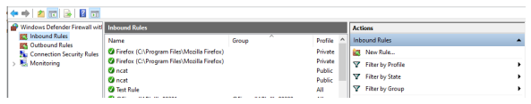
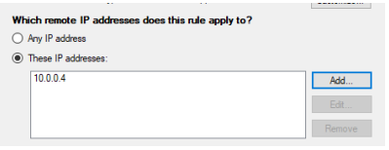
Lab experiment – 4
Create a Sandbox (Self Hosted Virtualbox) to Run Malware in Control Environment
Lab Layout - Self-Hosted (VirtualBox)
STEPS TO CONFIGURE VIRTUALBOX NETWORK SETTINGS
Open Windows Defender Firewall
Click "Inbound Rules" -> "New Rule..."
Choose Custom -> Next, All Programs -> Next, Leave default Protocol and Ports -> Next
Under the remote IP addresses, choose "Add", enter the Remnux IP address (10.0.0.4). Choose "Allow the connection", leave default for Profile, Name the rule -> Finish.

Slide 23
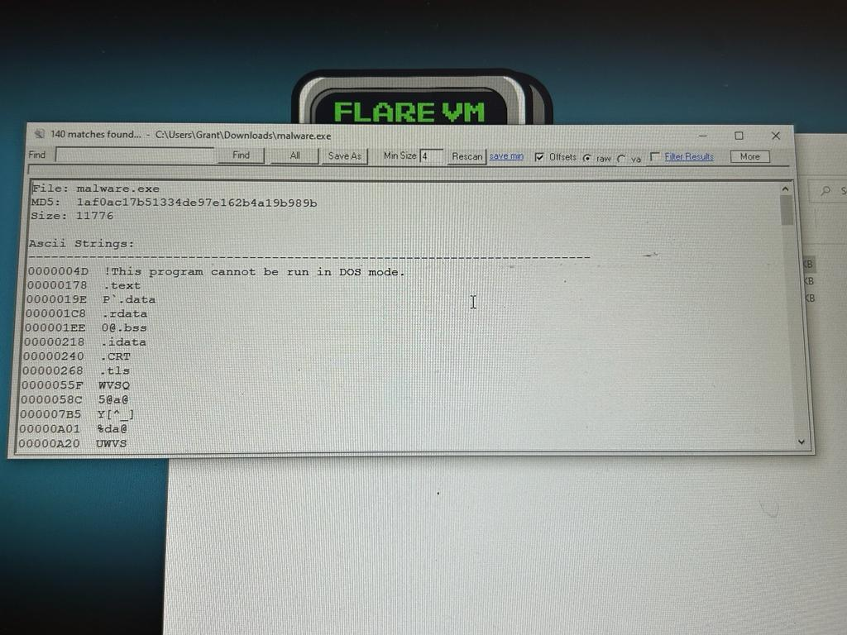
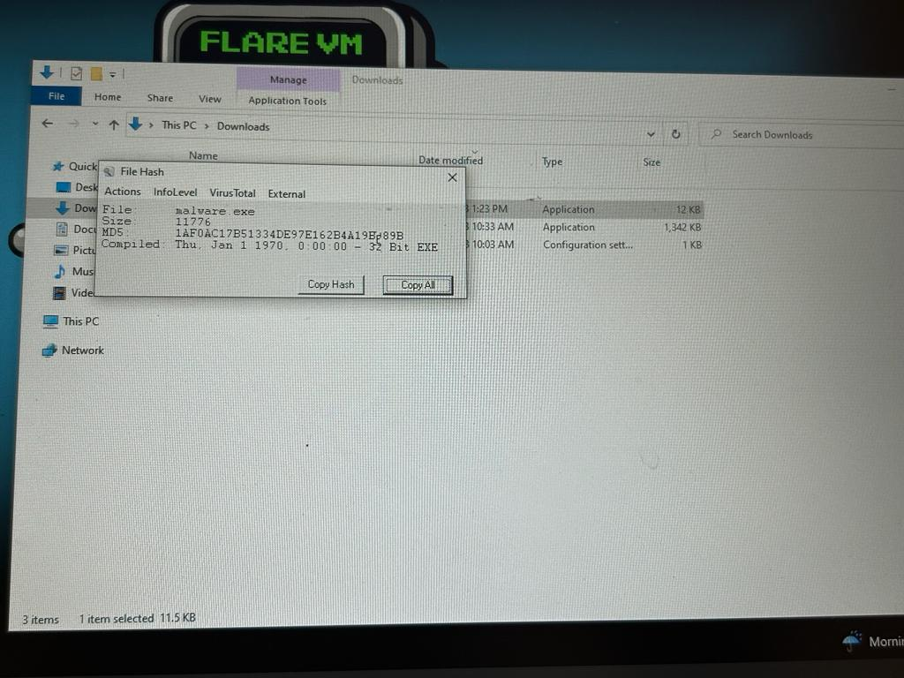
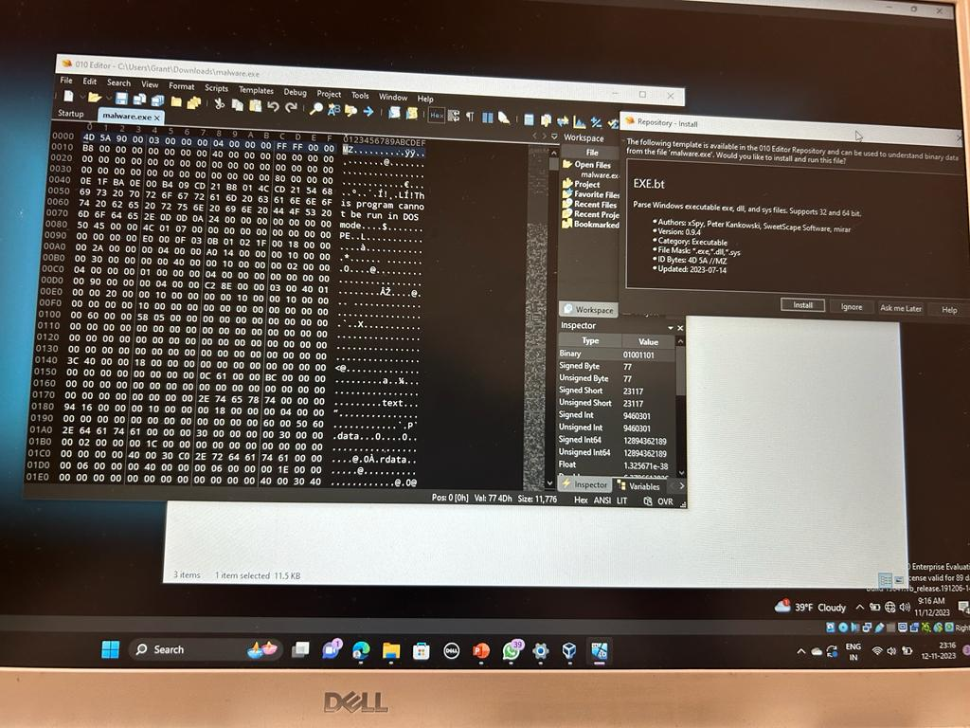
Lab experiment – 4
Create a Sandbox (Self Hosted Virtualbox) to Run Malware in Control Environment
RESULTS AFTER ANALYSING MALWARE SUCCESSFULLY

Slide 24
THANK YOU

